Slide 1
1

Slide 2

APPLIED CRYPTOGRAPHY
Lecture 40
2

Slide 3
Collision resistant hash function
No same hash value for different messages
3

Slide 4
Hash functions
A hash function is any function that can be used to map data of arbitrary size to fixed-size values.
The values returned by a hash function are called hash values, hash codes, digests, or simply hashes.
A hash function is a mathematical function (a process) for converting a numerical input value into a numerical output value

Slide 5
Iterated Cryptographic hash function
It compresses n bit string to create an m bit string where n>m
Iterated hash functions have a problem: the effort to generate lots of collisions scales sub-linearly.
Types
Merkle-Damgard scheme
Message Digest
Secure Hash Algorithm
Hash function based on block cipher
Rabin scheme
Davis meyer scheme
Matyas meyer oseas scheme
Miyaguchi-preneel scheme

Slide 6
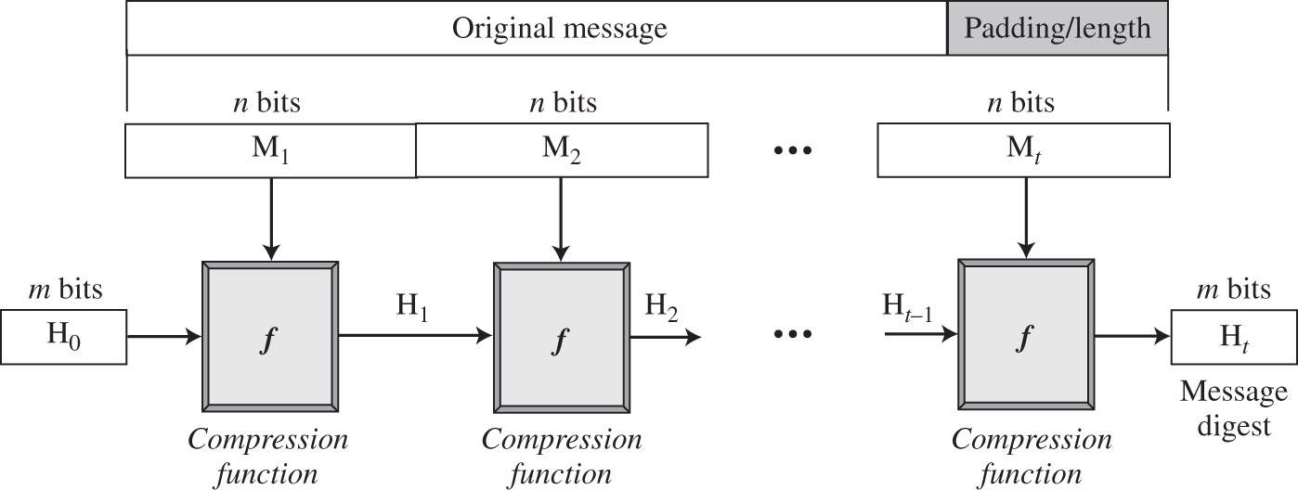
Merkle-Damgard scheme

Slide 7
Hash function based on block cipher
Use symmetric key block cipher as a compression functions

Slide 8
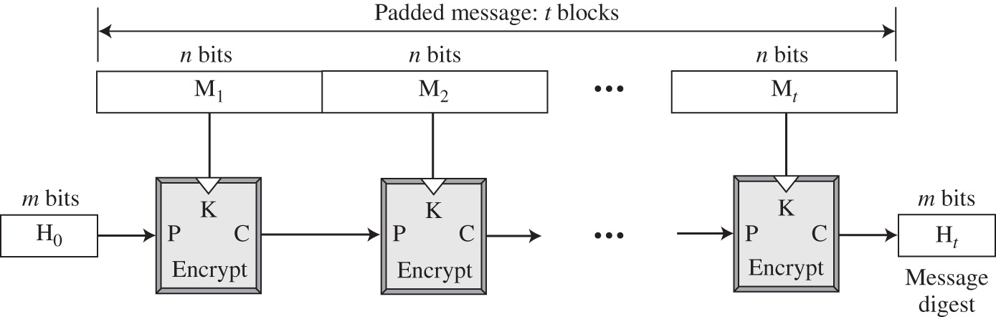
Rabin scheme

Slide 9
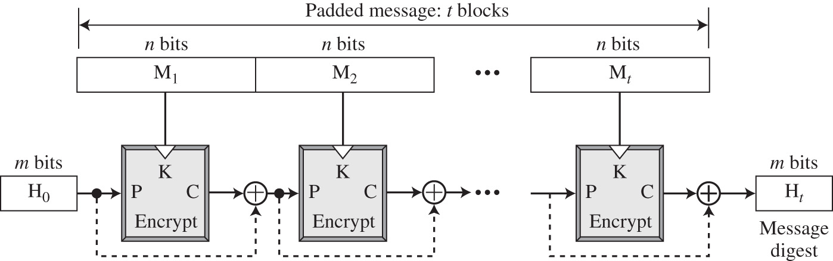
Davis meyer scheme

Slide 10
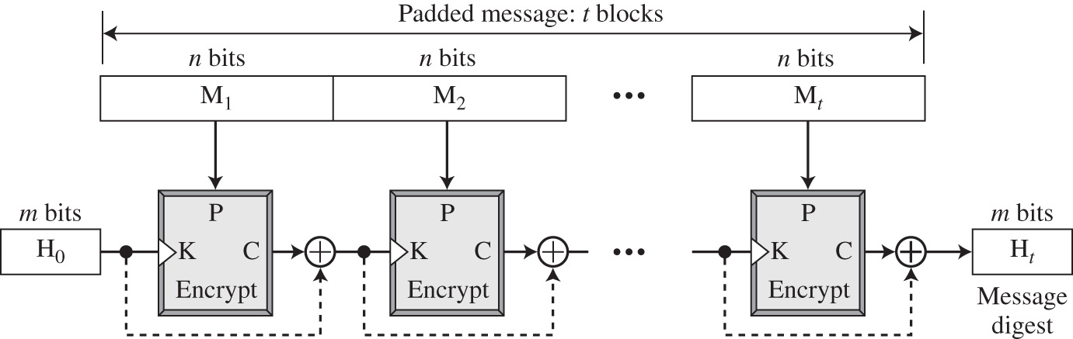
Matyas meyer oseas scheme

Slide 11
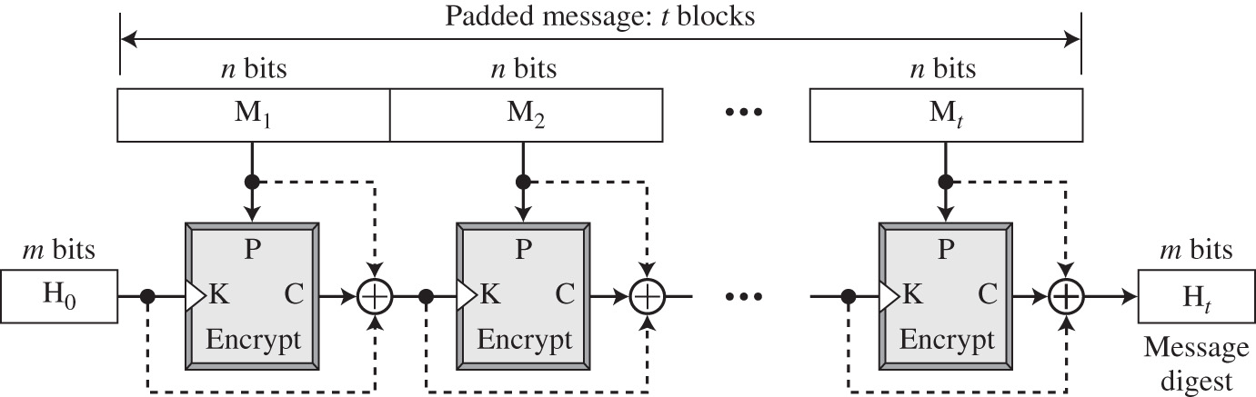
Miyaguchi-preneel scheme

Slide 12
Hash functions
(Cryptographic) hash function: deterministic function mapping arbitrary length inputs to a short, fixed-length output (sometimes called a digest)
Hash functions can be keyed or unkeyed
In practice, hash functions are unkeyed
We will assume unkeyed hash functions for simplicity

Slide 13
Collision-resistance
Let H: {0,1}* → {0,1}^{l} be a hash function
A collision is a pair of distinct inputs x, x’ such that H(x) = H(x’)
H is collision-resistant if it is infeasible to find a collision in H

Slide 14
Generic hash-function attacks
What is the best “generic” collision attack on a hash function H: {0,1}* → {0,1}^{l} ?
Note that collisions are guaranteed to exist…
If we compute H(x₁), …, H(x_{2l + 1}), we are guaranteed to find a collision
Can we do better?

Slide 15
“Birthday” attacks
Compute H(x₁), …, H(x_{k})
What is the probability of a collision?
Related to the so-called birthday paradox
How many people are needed to have a 50% chance that some two people share a birthday?

Slide 16
Theorem
The collision probability is O(k²/N)
When k ≈ N^{1/2}, probability of a collision is ≈ 50%
Birthdays: 23 people suffice!
Hash functions: O(2^{l/2}) hash-function evaluations
Need l=2n-bit output length to get security against attackers running in time 2^{n}
Note: twice as long as symmetric keys (e.g., block-cipher keys or PRG seeds) for the same security

Slide 17
“Birthday bound”
The birthday bound comes up in many other cryptographic contexts
Example: IV reuse in CTR-mode encryption
If k messages are encrypted, what are the chances that some IV is used twice?
Note: this is much higher than the probability that a specific IV is used again

Slide 18
Applications to message authentication

Slide 19
Intuition…
M
h
M
h =? H(M)
h = H(M)

Slide 20
Other applications of hash functions

Slide 21
Hash functions are ubiquitous
Collision-resistance ⇒ “fingerprinting”
Used as a one-way function
Used as a “random oracle”
Proofs of work

Slide 22
Fingerprinting
E.g., virus scanning
E.g., deduplication

Slide 23
Thank You!
Next Class
Mandatory reading for the next class
23

Slide 24


Rajashree S
Computer Science and Engineering
PES University, Bengaluru
10 June 2020
24

